Slide 1
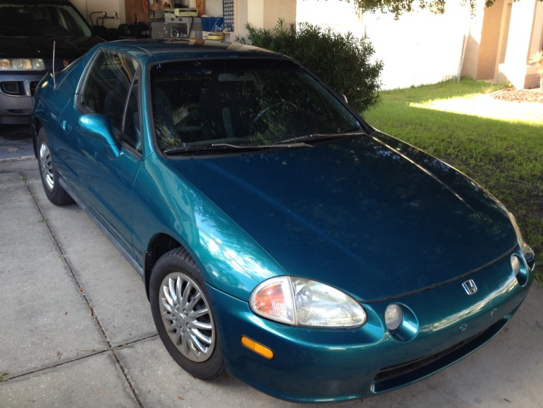
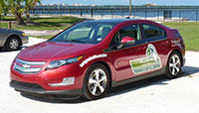


Electric Conversions
Show and Tell about Electric Cars

Slide 2
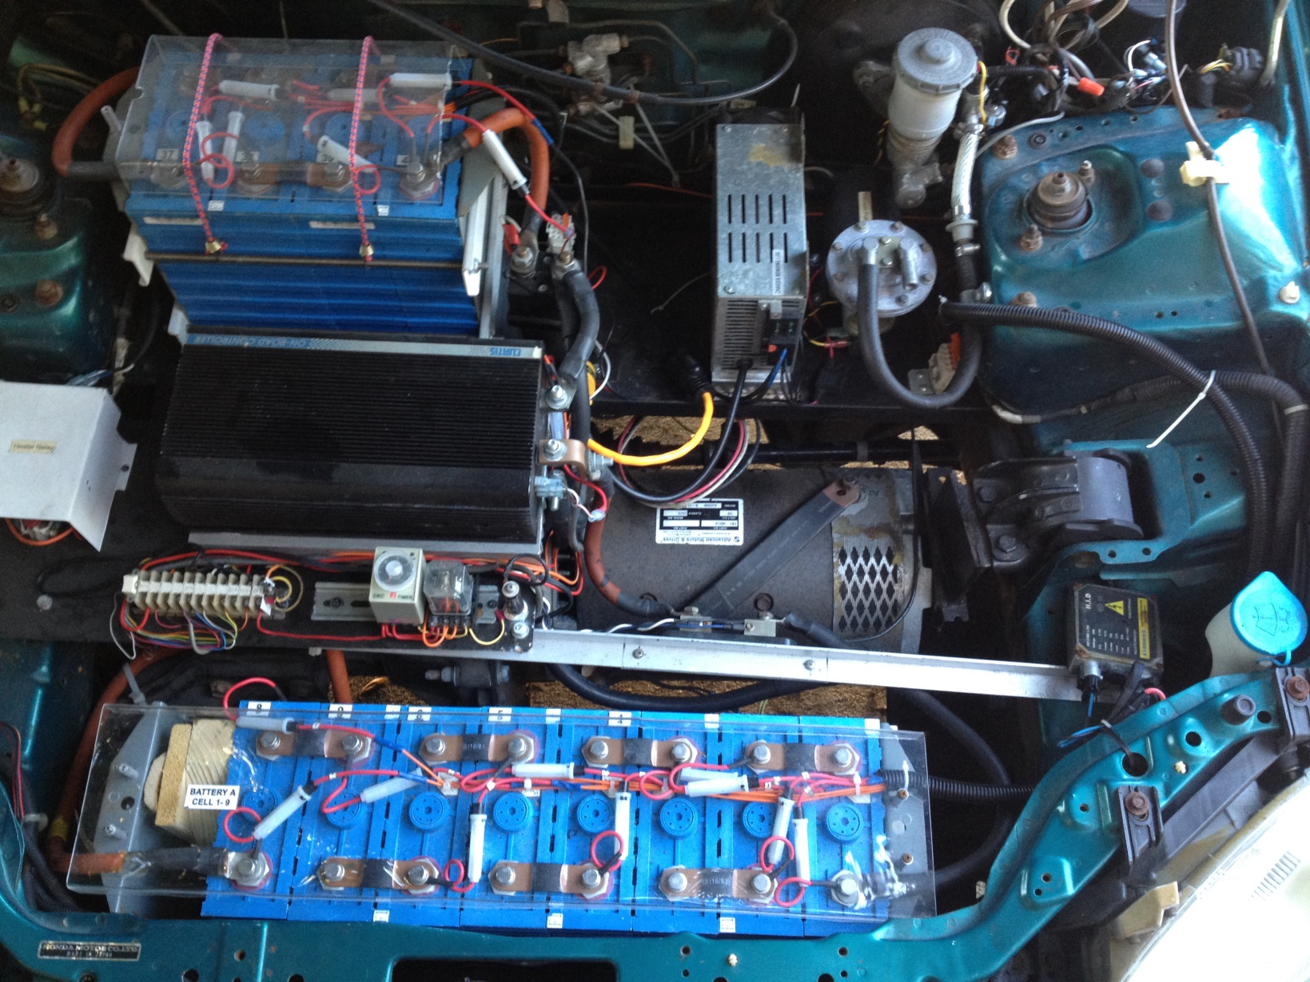
Conversion Credit
Peter Teer – Mechanical Engineer – Motortronics / Phasetronics

Slide 3
SAFETY FIRST!
Insulated tools & gloves
Eye protection
Cover battery terminals
Fuse all wires from main battery
Do not intentionally ground main battery
first ground is free
second ground is VERY expensive
Add “engineering safety margin” to device ratings.
Redundant protection when possible.
Don’t forget to unplug the charger when not in use!

Slide 4
Electric Motor The “Engine”

Slide 5
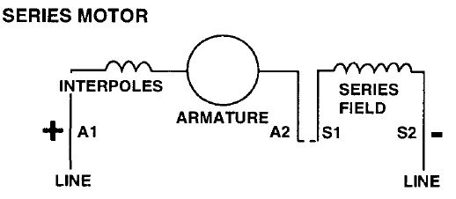
DC motor basics
*****Flux F u If *****
(Ia = If)
Flux F u Ia
F = B*L*Ia
Knowing B = F / da and F u Ia
F u Ia² ,but Torque is F * d ->
*****Torque u Ia²*****

Slide 6
DC motor basics
How does speed change with amps.
E_{O} = Z n F / 60, if we hold E_{O} and z constant
n u (1/F), but F u Ia
***** n u (1/Ia) *****

Slide 7
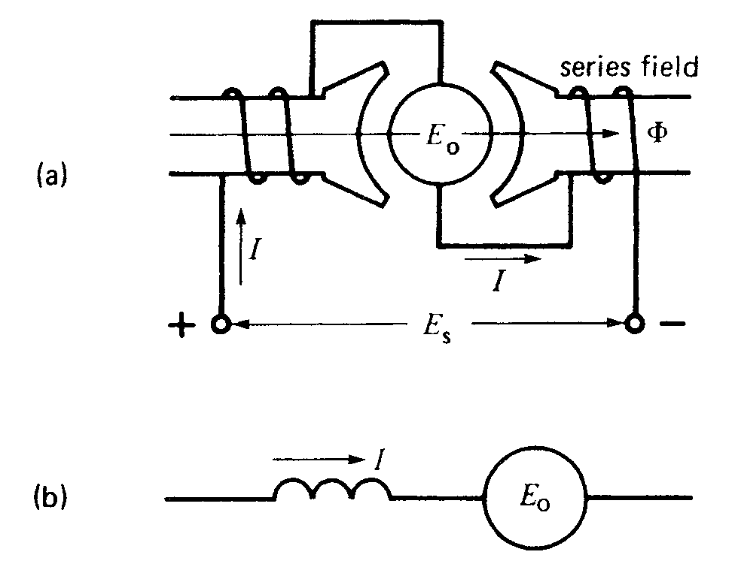
DC motor basics
Now for Torque vs Speed.
if n u (1/Ia) then n² u (1/Ia) ²
Rearranging
Ia² u (1/n) ²
From previous, we known that
T u Ia² , or T u (1/n) ²
Solving for n
*****n u 1/eT*****

Slide 8
DC motor basics
What if we change Es?
E_{S} = E_{O} + Ia*R, but Ra does not change ->
E_{S} u E_{O} + Ia, but E_{O} u n F and F u Ia so
E_{S} u n Ia + Ia u
*****E_{S} u Ia*****

Slide 9
Series DC motor basics
Summary:
Flux F u If u Ia
Torque u Ia²
n u (1/Ia)
n u 1/eT
E_{S} u Ia

Slide 10
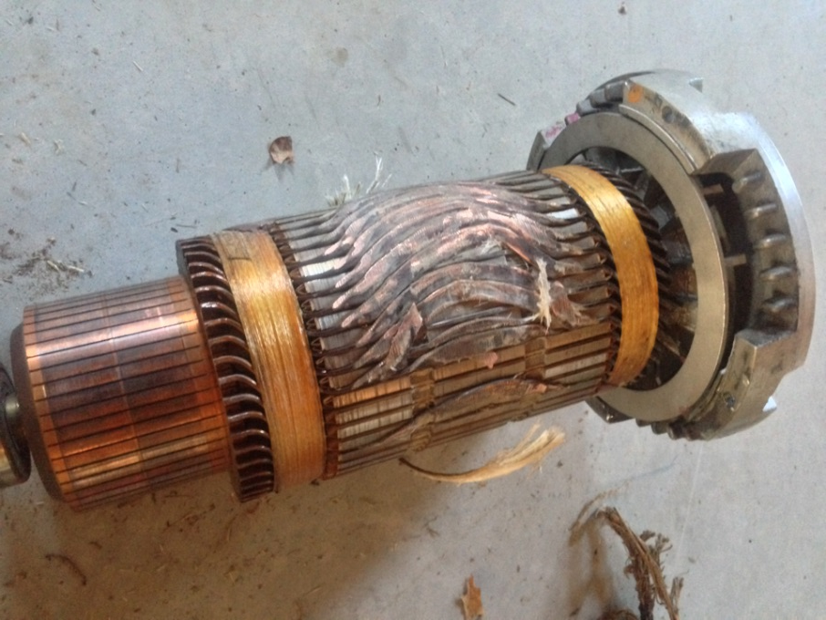
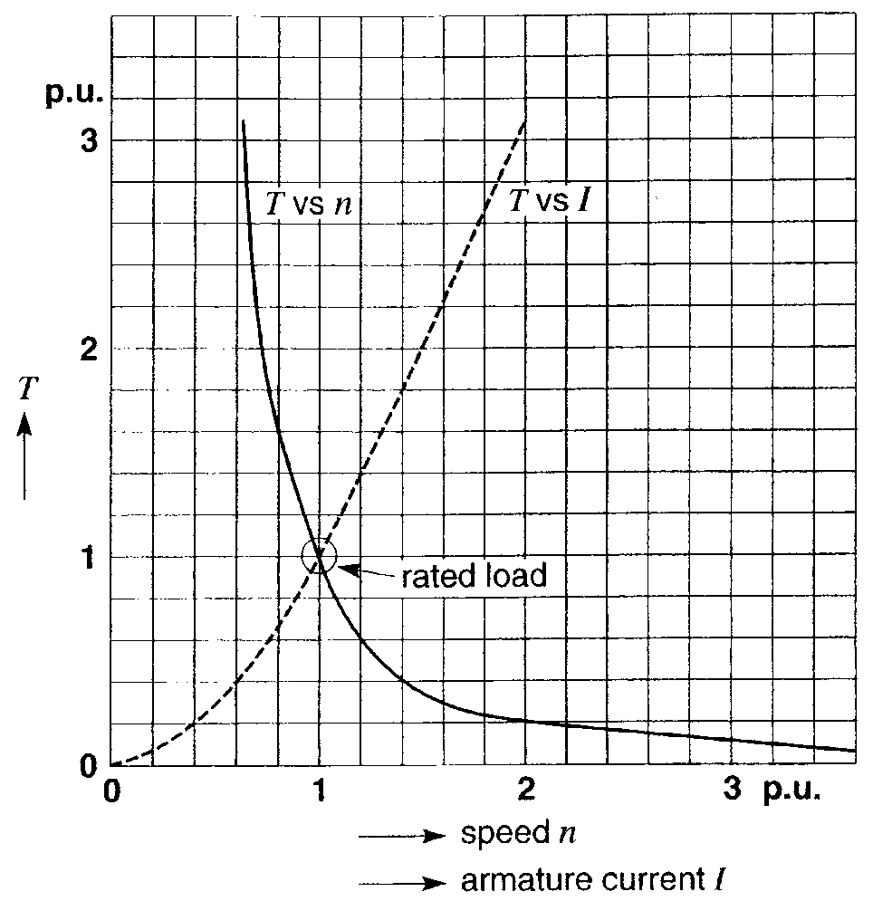
Series DC motor basics
For constant Es, what happens if the load is removed?
(For example if you depressed the clutch with armature current flowing)?

Slide 11
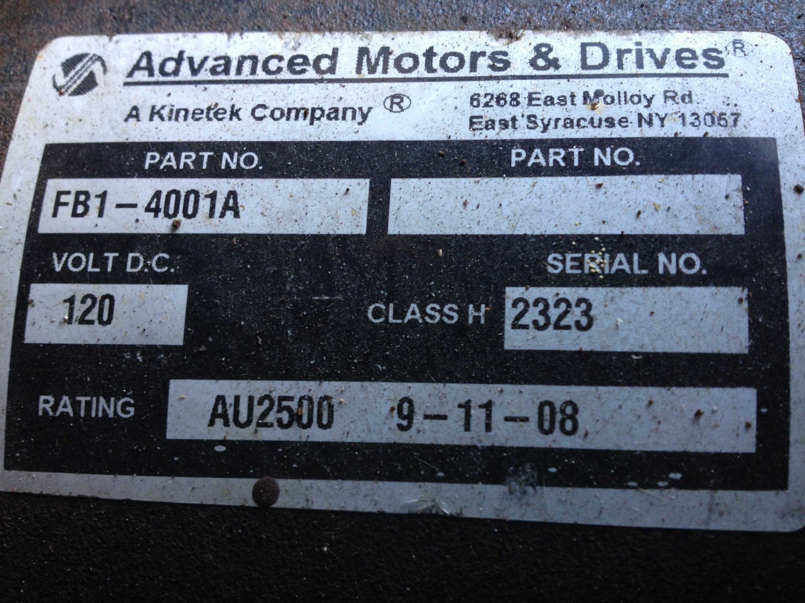
DC MOTOR
DC motor used in project car.

Slide 12
How about AC motor?
DC motor / controller less costly but AC motor less maintenance.
Hobbyist usually use DC, OEMs usually use AC
AC inverter set up for torque control not speed control
Requires tachometer feedback
AC must manage regeneration back into battery

Slide 13
Getting motor torque to the ground

Slide 14
Transmission
How to determine RPM of motor to speed of car?
Car Speed(MPH) = 60 * Motor RPM
(TGR * FDGR * WRPMi)
Where
TGR = Transmission Gear Ratio
FDGR = Final Drive Gear Ratio
WRPMi = Wheel Revolutions Per Mile
60 converts minutes to hours for units

Slide 15
Transmission
For Honda Del Sol (1995), 2.5L engine
1st TGR = 3.250
2nd TGR = 1.761
3rd TGR = 1.172
4th TGR = 0.909
5th TGR = 0.702
REV TGR = -3.153
FDGR = 4.058
wheel diameter | 23.3 | inches
wheel circumference | 73.19911 | inches
inches in 1 mile | 63360 | inches
revolutions / mile | 865.5843 | rev/mile

Slide 16
Transmission
motor speed | 1st | 2nd | 3rd | 4th | 5th | rev
RPM | MPH | MPH | MPH | MPH | MPH | MPH
400 | 2 | 4 | 6 | 8 | 10 | 2
800 | 4 | 8 | 12 | 15 | 19 | 4
1200 | 6 | 12 | 17 | 23 | 29 | 7
1600 | 8 | 16 | 23 | 30 | 39 | 9
2000 | 11 | 19 | 29 | 38 | 49 | 11
2400 | 13 | 23 | 35 | 45 | 58 | 13
2800 | 15 | 27 | 41 | 53 | 68 | 15

Slide 17
Batteries The “Gas Tank”

Slide 18
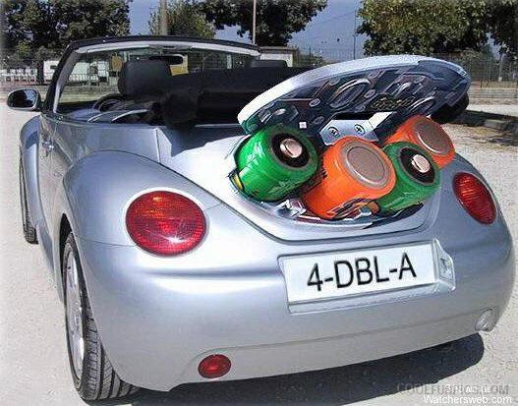
Batteries
Finding the right fit for your application.

Slide 19
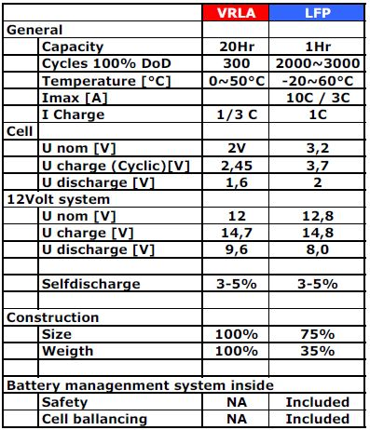
VRLA vs LiFePO4

Slide 20
LiFePO4 batteries
Main advantages of LiFePO4 (LFP)
–Cycles 2.000 to 3.000
•Lower cost of ownership
•Lower maintenance costs
–Temperature range -20 to 60°C
•No additional measures for outdoor applications
–High discharge current up to 10C
•If discharge time < 1h High capacity (95%) is available vs. VRLA (60%)
–High charge current 1C (VRLA < 1/3C)
•Shorter charge time higher availability

Slide 21
LiFePO4 batteries
(continued) Main advantages of LiFePO4 (LFP)
–High energy density 125Wh/Kg
•Smaller housing (75% less)
•Smaller weight (33% less)
–No heavy metals in the battery
•“Green battery”
–Does not suffer from "thermal runaway" .
LiFePO4 has Positive Temperature Coefficient (PTC). As Temperature increases, resistance increases, causing current to drop, reducing temp.
–Does not produce H₂ as byproduct of charging.

Slide 22
LiFePO4 batteries
VRLA – produces H⁺ when charging.
2H₂O <-> 4H⁺ + 4e⁻ + O₂
LFP (does not produce H⁺)
Li(1－x)FePO4 + xLi ⁺ + xe ⁻ <-> LiFePO4

Slide 23
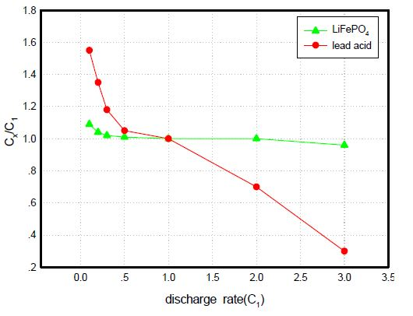
VRLA vs LiFePO4

Slide 24
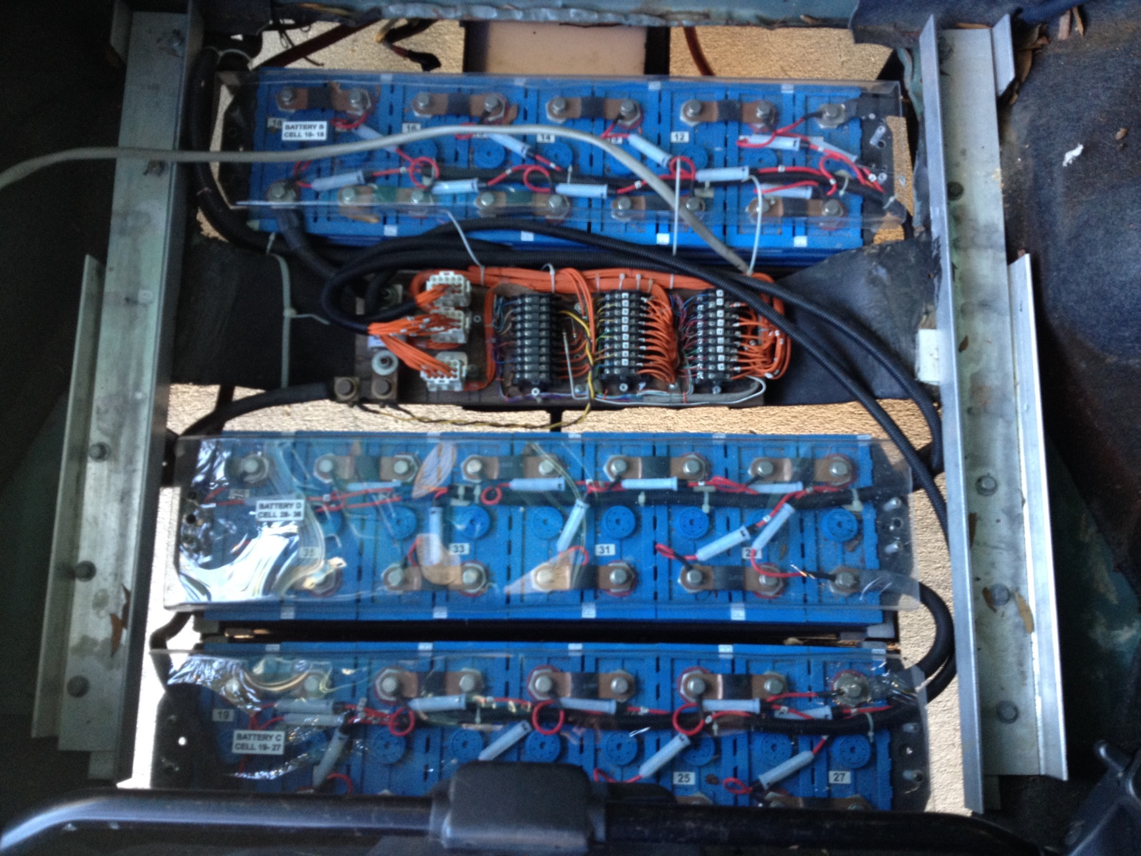
Electric Conversions
LiFePO4 batteries.

Slide 25
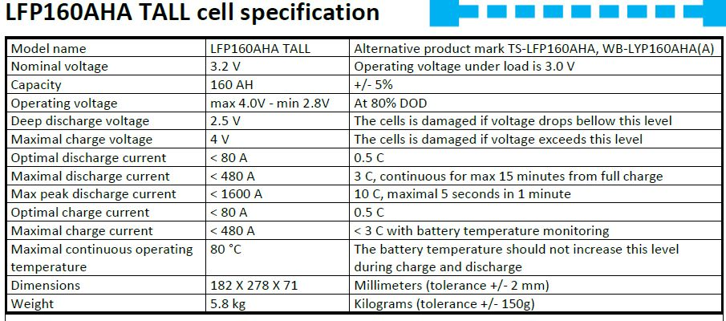
LiFePO4 batteries
LiFePO4 - 40 cells = 510 lbs
Equivalent VRLA (10, 12v cells) = 1200 lbs

Slide 26
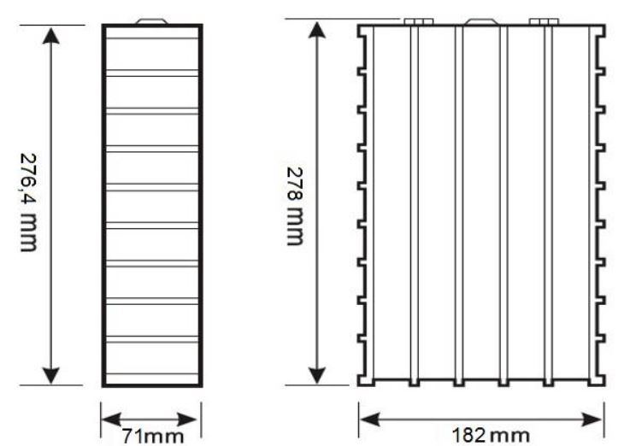
LiFePO4 batteries
11” X 7” X 2.7” (times 40 = lots of room!)
75% of size of VRLA

Slide 27
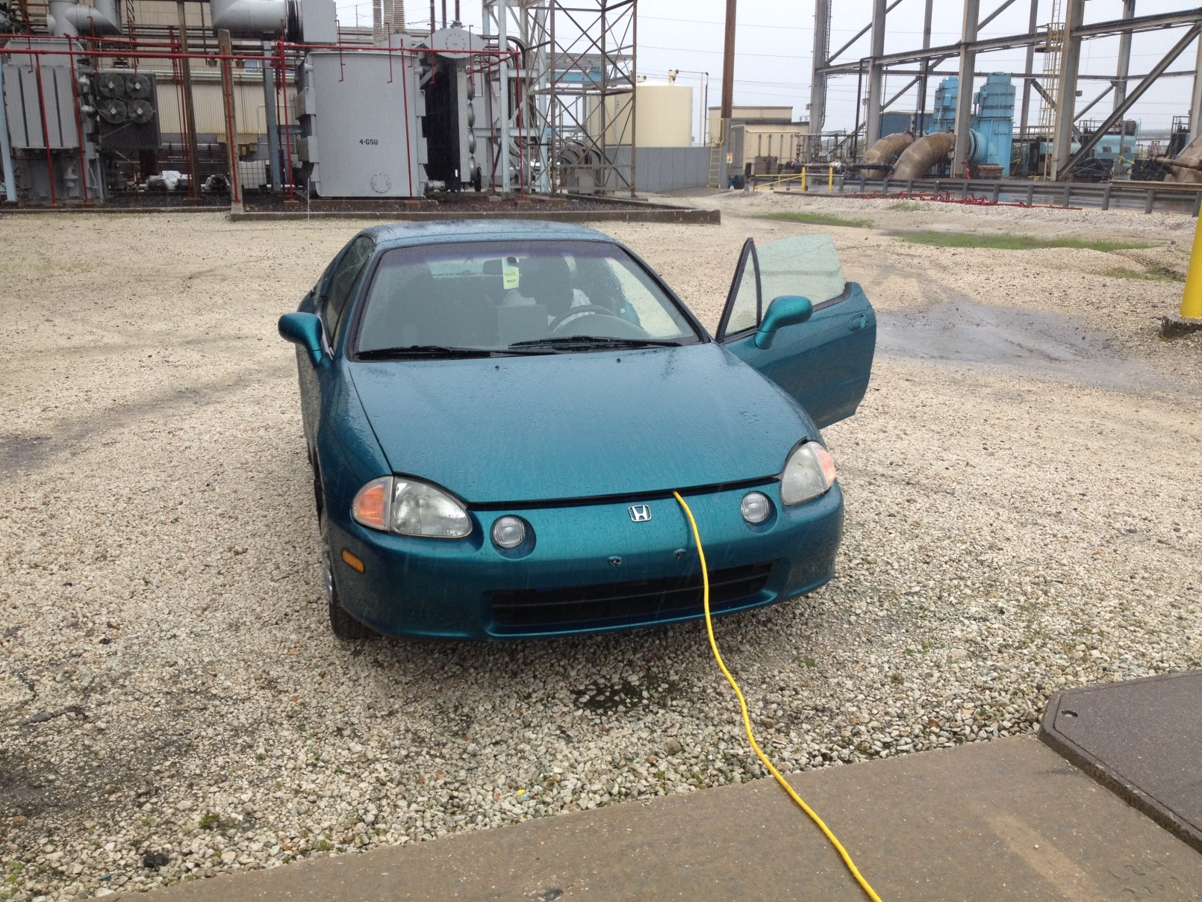
Unexpected Application
EV being used as 125Vdc station battery source during control panel test of GSU.

Slide 28
Cycle Analyst The “Gas Gauge”

Slide 29
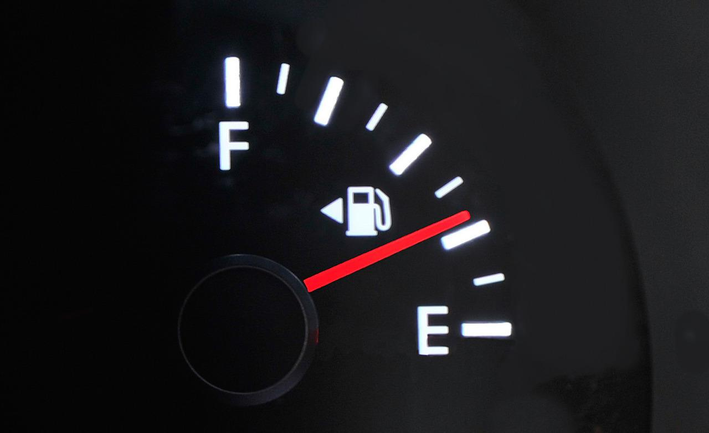
Cycle Analyst
Gallons of gas stored = AH of electronics stored.
160AH MEANS 160AH
Amp-hours (Ah) are the 'fuel' equivalent of a battery pack.

Slide 30
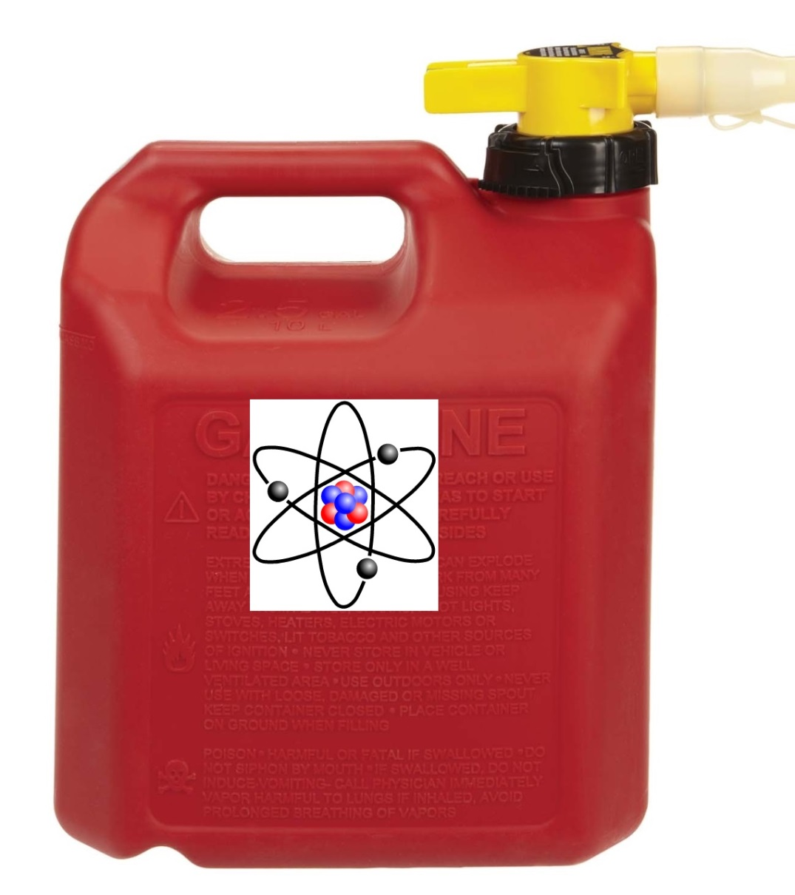
Cycle Analyst
You can not YET take your electron can to the local electron station to fill up on electrons
DON’T run out of electrons!

Slide 31

Range Anxiety

Slide 32
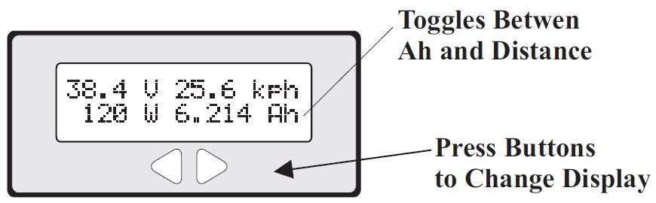
Cycle Analyst
Instead of estimating fuel left, AH tells you how much you have used.
Requires mental math to know how much is left.
160AH (fully charged) - 100AH (used) = 60AH left

Slide 33
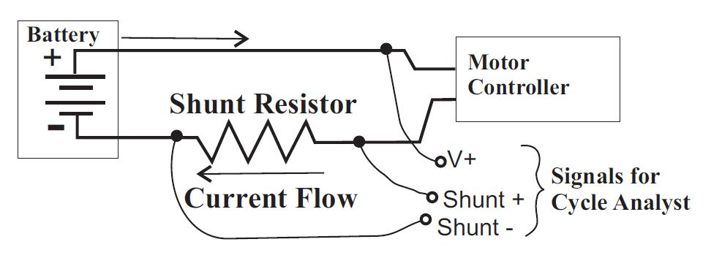
Cycle Analyst
Monitors current through shunt resistor
Vehicle speed via either magnet, or hall sensor

Slide 34
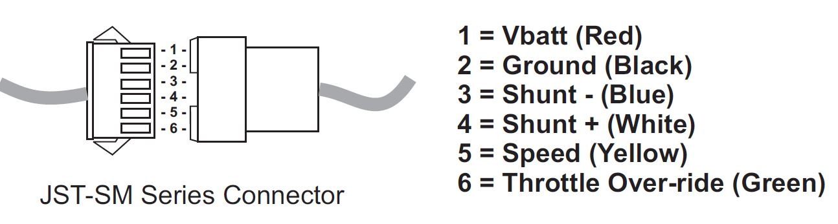
Cycle Analyst
In addition to A, AH & speed, analyst provides:
-Battery voltage
-Watts
-Watt-hours
-Wh/mi
-Amin & Amax
-Vmin
-Max & average speed
-Total cycles, total AH, and total miles

Slide 35
Charging System The “Gas Station”

Slide 36
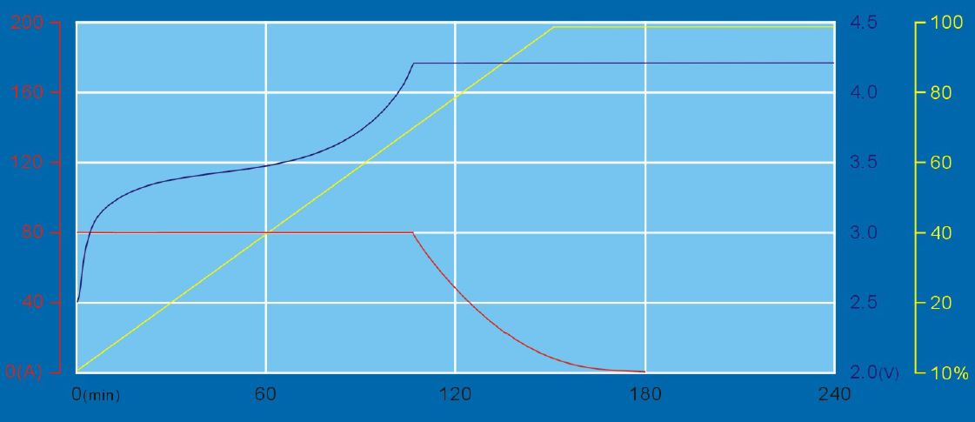
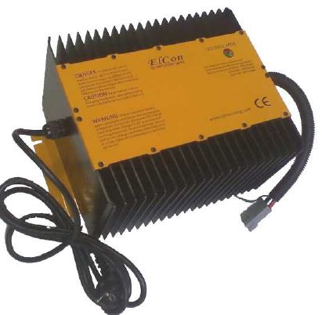
Charging System
Existing charger is for VRLA.
OK to use on LiFePO4, but following limits;
Only has 8A current limit charge.
No voltage limit at end of charge.
My wish list –
Will replace with unit with both CL and VL

Slide 37
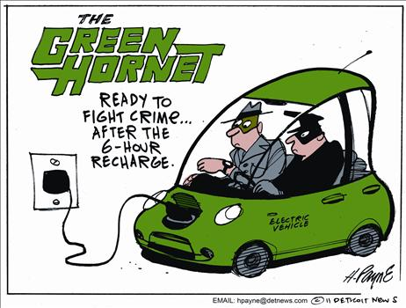
Electric Conversions
How long to charge? - Its all about the AH.
To charge 160AH at 8A takes 20H
To charge 160AH at 16A takes 10H
To charge 160AH at 32A takes 5H
Benefit of 240vac charger, typically double the charging current results in ½ the charging time

Slide 38
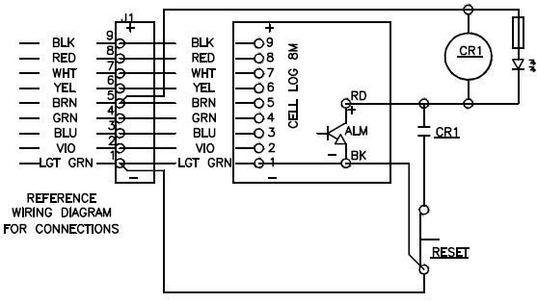
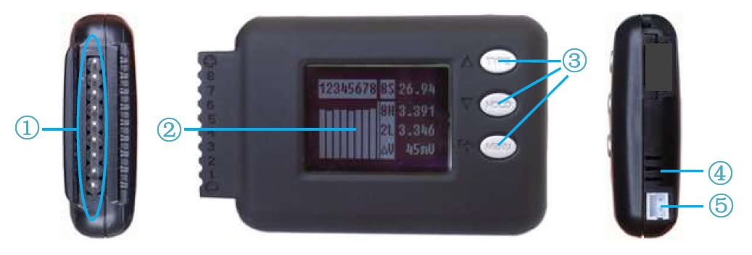
Charge Monitoring
Utilize “Celllog8 M” to monitor individual cell voltages. (8 X 5 = 40 cells)
OCT output energizes when first cell hits Vmax
Circuit below used to remove power to charger.

Slide 39
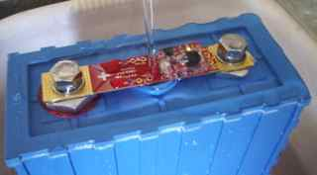
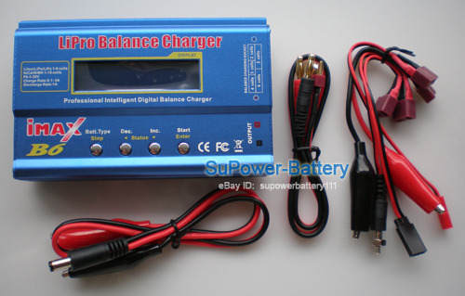
Cell Balance
Automatic
LiFePO4 does not inherently balance.
Either manually balance or automate balance
Manual
My wish list –
Automate.

Slide 40
PWM controller The “Fuel injection system”

Slide 41
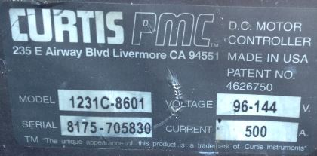
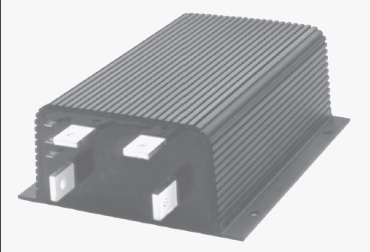
Controller
Curtis PMC Model 1231C-86xx
Nominal Battery Volts:96-144 Vdc
Current Limit: 500A
2 min rating : 500A
5 min rating: 375A
1 hour rating: 225A
Voltage drop @ 100A: 0.3 Vdc
Undervolt cutoff: 64Vdc

Slide 42
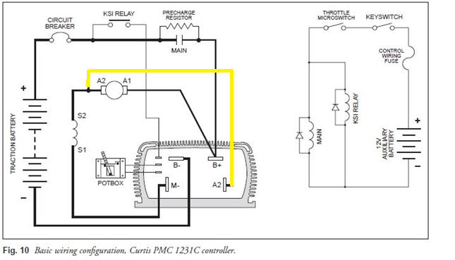
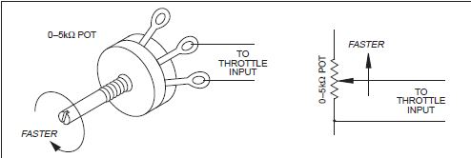
Electric Conversions
Connections – Pre-charge 750 ohm
KSI – Key Switch Input
A2 for plug braking.
Not used & not wired

Slide 43
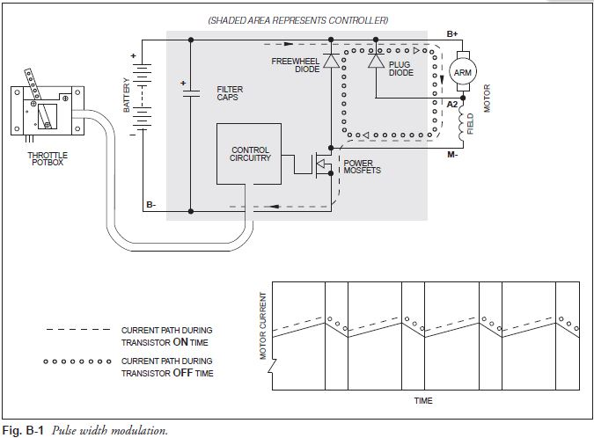
Electric Conversions
Freewheel Diode Function.

Slide 44

How do we stop?

Slide 45
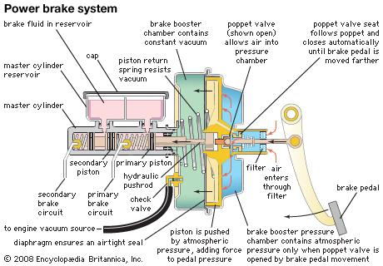
Braking System
Braking system needs vacuum source – vacuum pump

Slide 46
What is the cost to convert? aka … “Mom & Dad, can I get a loan?”

Slide 47
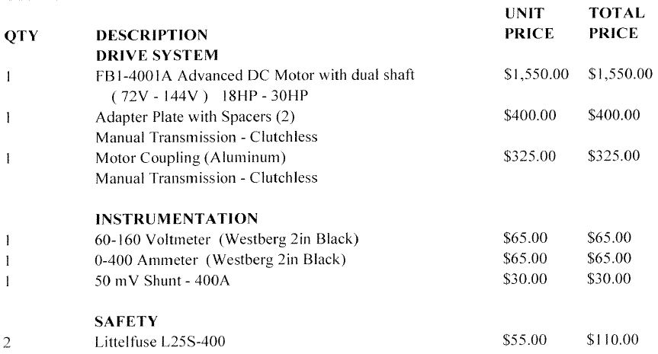
Electric Conversions
Cost: (Electric Vehicles of America Quote)

Slide 48
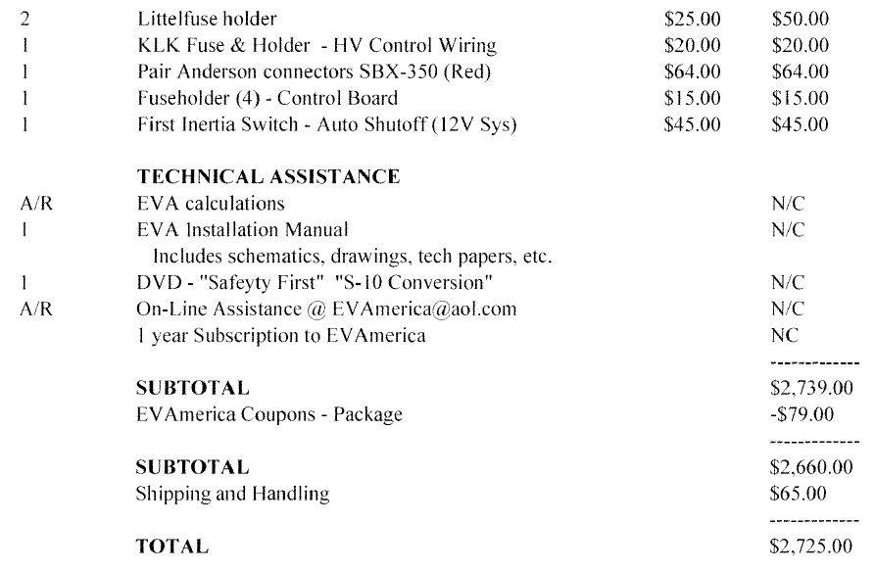
Electric Conversions
Cost: (Continued)

Slide 49
Electric Conversions
Additional costs:
The “donor” car
Curtis PMC controller
Cycle analyst (or AH meter)
Battery charger
BMS (Battery management system)
Vacuum pump for hydraulic brakes
Duct heater & control relays
??? Did we forget anything ???

Slide 50
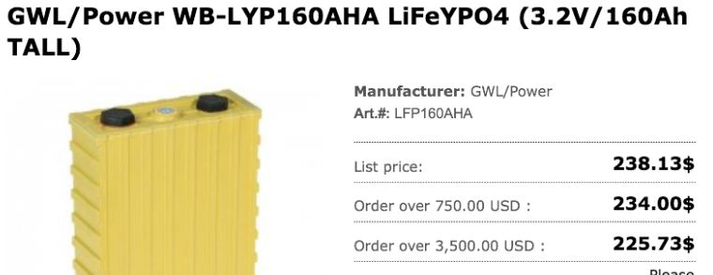
Electric Conversions
The BATTERY (the largest single expense!!!)
VRLA (12V, 160ah) = $606.16*10= $6,061.60
LiFePO4 (3.2V, 160ah) = $225.73*40= $9,029.20

Slide 51
Electric Conversions
True cost of the battery per mile (VRLA vs LiFePO4!
VRLA LiFePO4
# of cycles | 300 | 3000
A*H per cycle | 160 | 160
Total Life A*H | 48000 | 480000
Total Miles (2.2AH/MI) | 21818.18 | 218181.8
Cost for Battery | 6061.6 | 9029.2
Cost / Mi | 0.28 | 0.04

Slide 52

Electric Conversions
Don’t forget the cost of an ample amount of:
“Elbow Grease”

Slide 53
What is the cost to drive?

Slide 54
Electric Conversions
Del Sol gets 2.2 AH / Mile.
@ 125vdc, [2.2AH * 125vdc] = 0.275kwh
Assume energy costs $0.10 / kwh.
Del sol costs about $0.0275 / mile to drive.
@ 2.2 AH / Mile and a 160AH battery,
Can travel up to 72 miles on a full charge.
A full charge costs;
72 miles * $0.0275 / mile = $2 for full charge

Slide 55
Electric Conversions
Users group
http://www.electricauto.org/
Teco website http://www.tampaelectric.com/company/electricvehicles/
Parts
http://www.ev-america.com/

